Slide 1


7PAM2002-0901-2024 - DATA SCIENCE PROJECT FAKE NEWS DETECTION
STUDENT ID: 22081557
STUIDENT NAME: KAMALI BAKTHAVATCHALAM.
WELCOME

Slide 2

Why fake news detection?
The use of various techniques—especially machine learning and natural language processing—to identify and classify news articles as either real (true) or fake (false or misleading). This process typically involves:
Protecting Public Opinion
Enhancing trust in media
Supporting Researchers Policymakers
Preserving Democracy

Slide 3

RESEARCH QUESTION: "How effective are machine learning algorithms in distinguishing between real and fake news articles using textual features?"
Objective: The goal is to assess and compare the performance of various machine learning algorithms for classifying news articles as real or fake.
Algorithms:
Support Vector Machines : high-dimensional spaces, making it suitable for text classification.
Random Forest: reduces overfitting and improves accuracy by averaging multiple decision trees.
Performance Metrics:
Accuracy: correctness of the model
Precision and Recall: balance between false positives and false negatives.

Slide 4
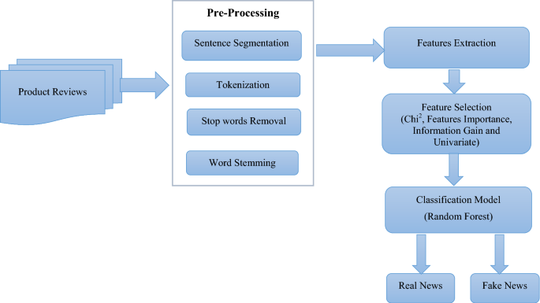

Project Objectives
Pre-process and analyse the dataset.
Implement various machine learning algorithms.
Evaluate and compare performance.
Provide insights into significant features.

Slide 5

Project Plan - Task List
Task & Description | Timeline
Literature Review: Review existing research on fake news detection methodologies. | Sept 25 -1, 2024
Data Pre-processing: Clean and pre-process the Fake News Dataset for analysis. | Oct 2 -8, 2024
Feature Engineering: Extract relevant features from the dataset for model training. | Oct 9, -15, 2024
Model Implementation: Implement machine learning algorithms (e.g., SVM, Random Forest). | Oct 16-29, 2024
Model Evaluation: Evaluate model performance using accuracy, precision, and recall. | Oct 30-5, 2024
Final Report and Presentation Prep: Compile results and prepare presentation materials. | Nov 6-19, 2024
Review and Revisions: Make necessary revisions to report and presentation based on feedback. | Nov 20-26, 2024
Final Presentation Prep: Finalize presentation materials and practice delivery. | Nov 27- 1, 2024

Slide 6
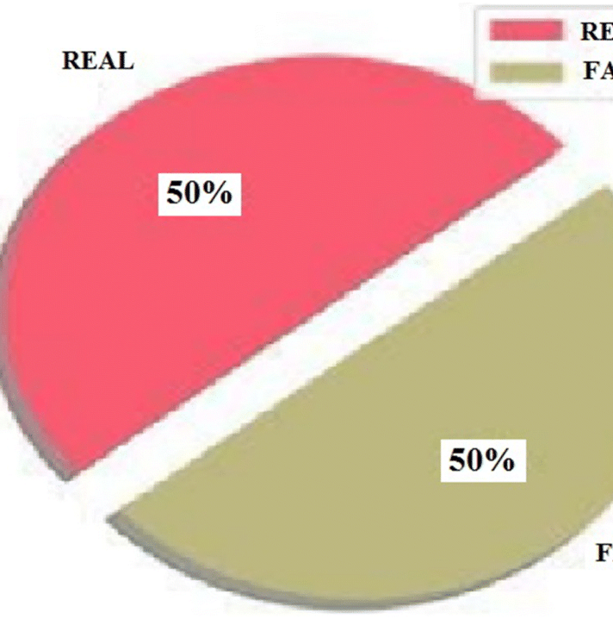
Overview of the Dataset:
Overview of the Dataset:
Source: Kaggle Fake News Dataset.
Description: Contains labelled news articles (fake vs. real) with textual content, including headlines and body text.
Size: Approximately 20,000 records; expected size of the dataset is around 1 GB
FILE:CSV.

Slide 7


GDPR Compliance: No personal data is included, so GDPR does not apply. University Policies: Adheres to university ethical guidelines for data research. Permission for Use: Dataset is publicly available on Kaggle for academic use. Data Collection Ethics: Collected and labeled by credible sources, upholding ethical standards.
Ethical Requirements
Conclusion
This project demonstrates the effectiveness of machine learning algorithms in detecting fake news. By analyzing a dataset, we identified key algorithms that excel in classification tasks. Ultimately, this research contributes to the ongoing fight against misinformation, promoting a more informed public.

